Slide 1
Hello Node
NodeSchool. - Lecture - 1

Slide 2
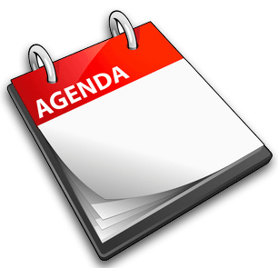
Agenda:
JavaScript async programming
Event loop
Async programming techniques
Hello Node
Blocking vs non-blocking code

Slide 3
Q: What are these threads doing, most of the time?
A: waiting

Slide 4
In non-web languages, most of the code we write is synchronous.
aka blocking

Slide 5
In JavaScript, we do things differently.
There’s only one thread in JavaScript, so we use that thread to get stuff done.

Slide 6
OK, let’s talk about…
The event loop
Callbacks
Promises
Observables
Coroutines

Slide 7
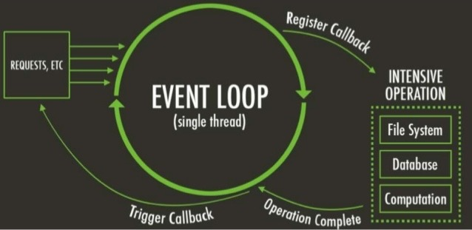

Slide 8
You’ve seen event loops before:

Slide 9
int WINAPI WinMain(HINSTANCE hInstance, HINSTANCE hPrevInstance, LPSTR lpCmdLine, int nCmdShow) { MSG msg; while (GetMessage(&msg, NULL, 0, 0) > 0) { TranslateMessage(&msg); DispatchMessage(&msg); } return msg.wParam; }

Slide 10
this.btnOK.Click += this.btnOK_Click; private void btnOK_Click(object sender, EventArgs e) { // ... }

Slide 11
$("#ok-button").click(function () { // ... }); setTimeout(function () { // ... }, 100); $.get("http://example.com", function (result) { // ... });

Slide 12
Some event loop subtleties
Yielding
Async’s not sync
Errors
It’s not magic

Slide 13
Yielding
console.log("1"); $.get("/echo/2", function (result) { console.log(result); }); console.log("3"); // 1, 3, 2

Slide 14
Async’s not sync
var hi = null; $.get("/echo/hi", function (result) { hi = result; }); console.log(hi); // null

Slide 15
Errors
console.log("About to get the website..."); $.ajax("http://sometimesdown.example.com", { success: function (result) { console.log(result); }, error: function () { throw new Error("Error getting the website"); } }); console.log("Continuing about my business...");

Slide 16
It’s not magic
function fib(n) { return n < 2 ? 1 : fib(n-2) + fib(n-1); } console.log("1"); setTimeout(function () { console.log("2"); }, 100); fib(40); // 1 ... 15 seconds later ... 2

Slide 17
The event loop is tricky… but powerful.

Slide 18
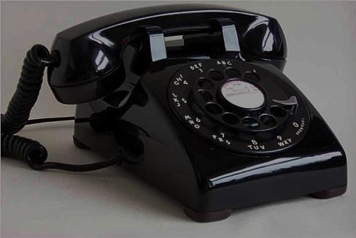
Callbacks

Slide 19
What we’ve seen so far has been doing asynchronicity through callbacks.

Slide 20
Callbacks are OK for simple operations, but force us into continuation passing style.

Slide 21
Recurring StackOverflow question:
function getY() { var y; $.get("/gety", function (jsonData) { y = jsonData.y; }); return y; } var x = 5; var y = getY(); console.log(x + y);
Why doesn’t it work???

Slide 22
After getting our data, we have to do everything else in a continuation:

Slide 23
CPS Headaches
Doing things in sequence is hard
Doing things in parallel is harder
Errors get lost easily

Slide 24
Doing things in sequence is hard
$("#button").click(function () { promptUserForTwitterHandle(function (handle) { twitter.getTweetsFor(handle, function (tweets) { ui.show(tweets); }); }); });

Slide 25
Doing things in parallel is harder
var tweets, answers, checkins; twitter.getTweetsFor("domenicdenicola", function (result) { tweets = result; somethingFinished(); }); stackOverflow.getAnswersFor("Domenic", function (result) { answers = result; somethingFinished(); }); fourSquare.getCheckinsBy("Domenic", function (result) { checkins = result; somethingFinished(); });

Slide 26
Doing things in parallel is harder
var finishedSoFar = 0; function somethingFinished() { if (++finishedSoFar === 3) { ui.show(tweets, answers, checkins); } }

Slide 27
Errors get lost easily
function getTotalFileLengths(path, callback) { fs.readdir(path, function (err, fileNames) { var total = 0; var finishedSoFar = 0; function finished() { if (++finishedSoFar === fileNames.length) { callback(total); } } fileNames.forEach(function (fileName) { fs.readFile(fileName, function (err, file) { total += file.length; finished(); }); }); }); }

Slide 28
You could write your own library to make this nicer…

Slide 29
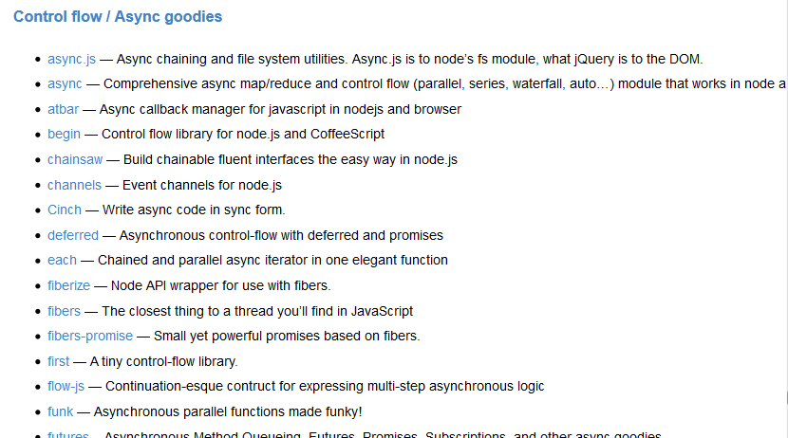
And in fact many people have:

Slide 30


PROMISES

Slide 31
Un-inverts the chain of responsibility: instead of calling a passed callback, return a promise.

Slide 32
Why promises better that callbacks
Cleaner method signatures
Uniform return/error semantics
Easy composition
Easy sequential/parallel join
Always async
Exception-style error bubbling

Slide 33

Observer

Slide 34
Why observables better that promises
Promise always run
Promise can be canceled (bluebird excepted)
You can choose between hot and cold observables
You can merge observables
You can build observable from promise

Slide 35

Coroutines

Slide 36
“Coroutines are computer program components that generalize subroutines to allow multiple entry points for suspending and resuming execution at certain locations.”

Slide 37
Async code in sync style
await $("#button").clickPromise(); var handle = await promptUserForTwitterHandle(); var tweets = await twitter.getTweetsFor(handle); ui.show(tweets);

Slide 38

Node

Slide 39
What is the node?
Allows you to build scalable network applications using JavaScript on the server-side.

Slide 40
What could you build
Websocket Server
Fast File Upload Client
Ad Server
Any Real-Time Data Apps

Slide 41
What is Node not
A Web framework
For beginners
Multi-Thread

Slide 42
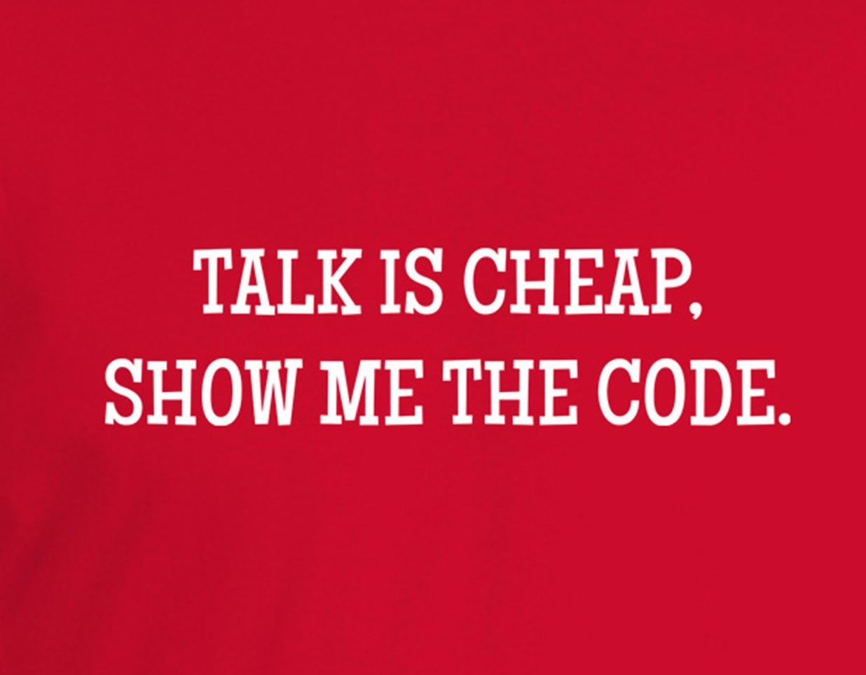
Talk is chip! Show me the code!

Slide 43
Node modules quick overview
http
events
fs
path
process
stream
util

Slide 44
Blocking vs Non-Blocking code
Blocking code
Non-Blocking code

Slide 45
Event emitter

Slide 46
Thank you for your attention

